Slide 1
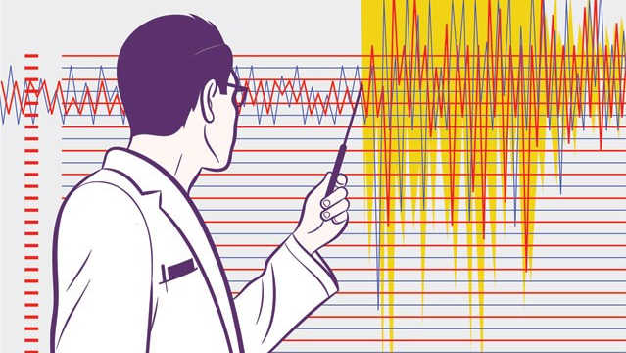
Earthquake Prediction
By Henrik Mjaaland, Andrijana Podhraski and Inam Alissi

Slide 2
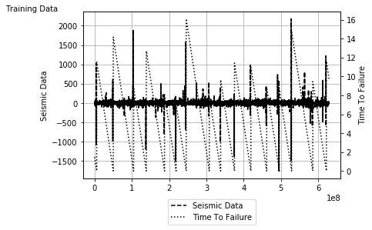
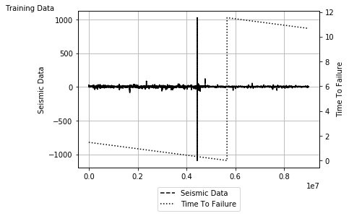
Preprocessing
Visualization
Incomplete data
Noise
Statistical descriptors
Min-Max Feature Scaling
16 failures in training data

Slide 3
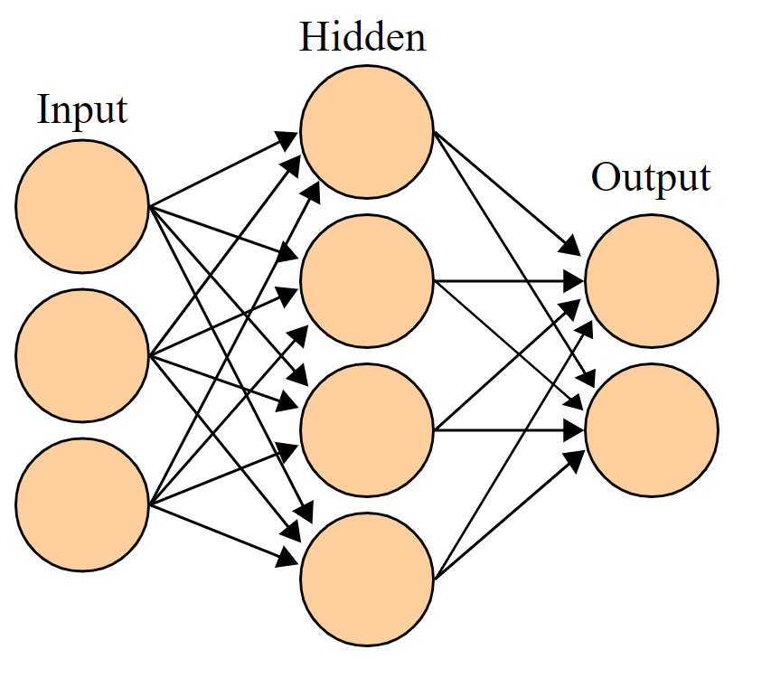
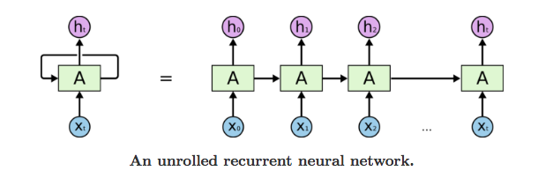
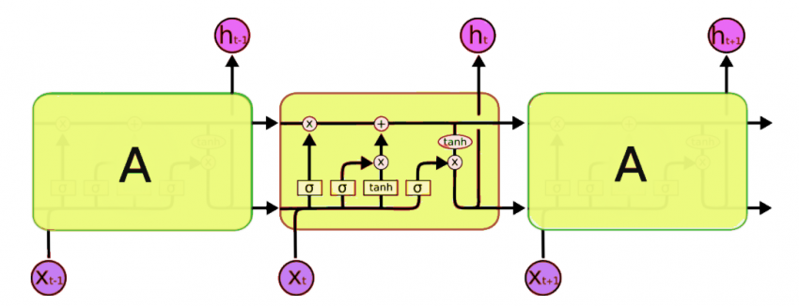
Recurrent Neural Networks - LSTM
Three layers
Each node has its own classifier
Activation not random
Training done in epochs
Used for sequential data
Consists of memory block cell(s)
The vanishing gradient problem
Most terms in the first hidden layers
Cells consists of three main components
Solves vanishing gradient problem using the forget gate

Slide 4
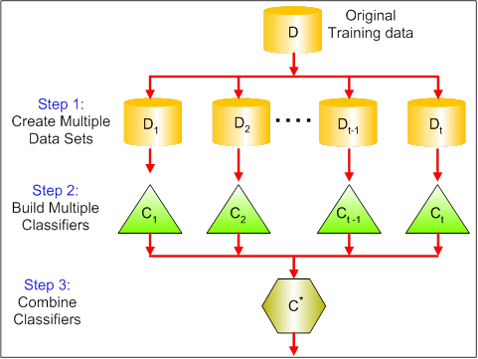
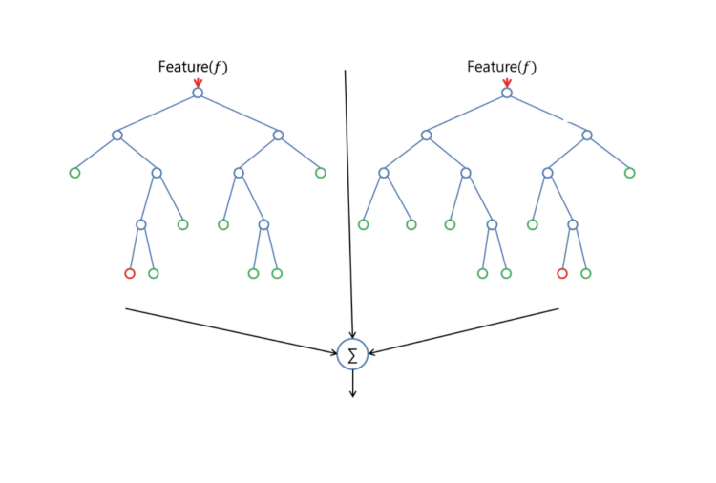
Random Forest
Ensemble method improves classification accuracy by aggregation
Prevents overfitting by creating random subsets of the features and
building smaller trees using these subsets (redundant features)
The goal: a reduction of the variance
Three approaches to randomization: randomly select F features to split at
each node (Forest-RI), add F linear combinations of features (Forest-RC),
randomly select one of the F best splits at each node
Hyperparameters selection: Grid Search (n_estimators, max_features,
min_sample_leaf)

Slide 5
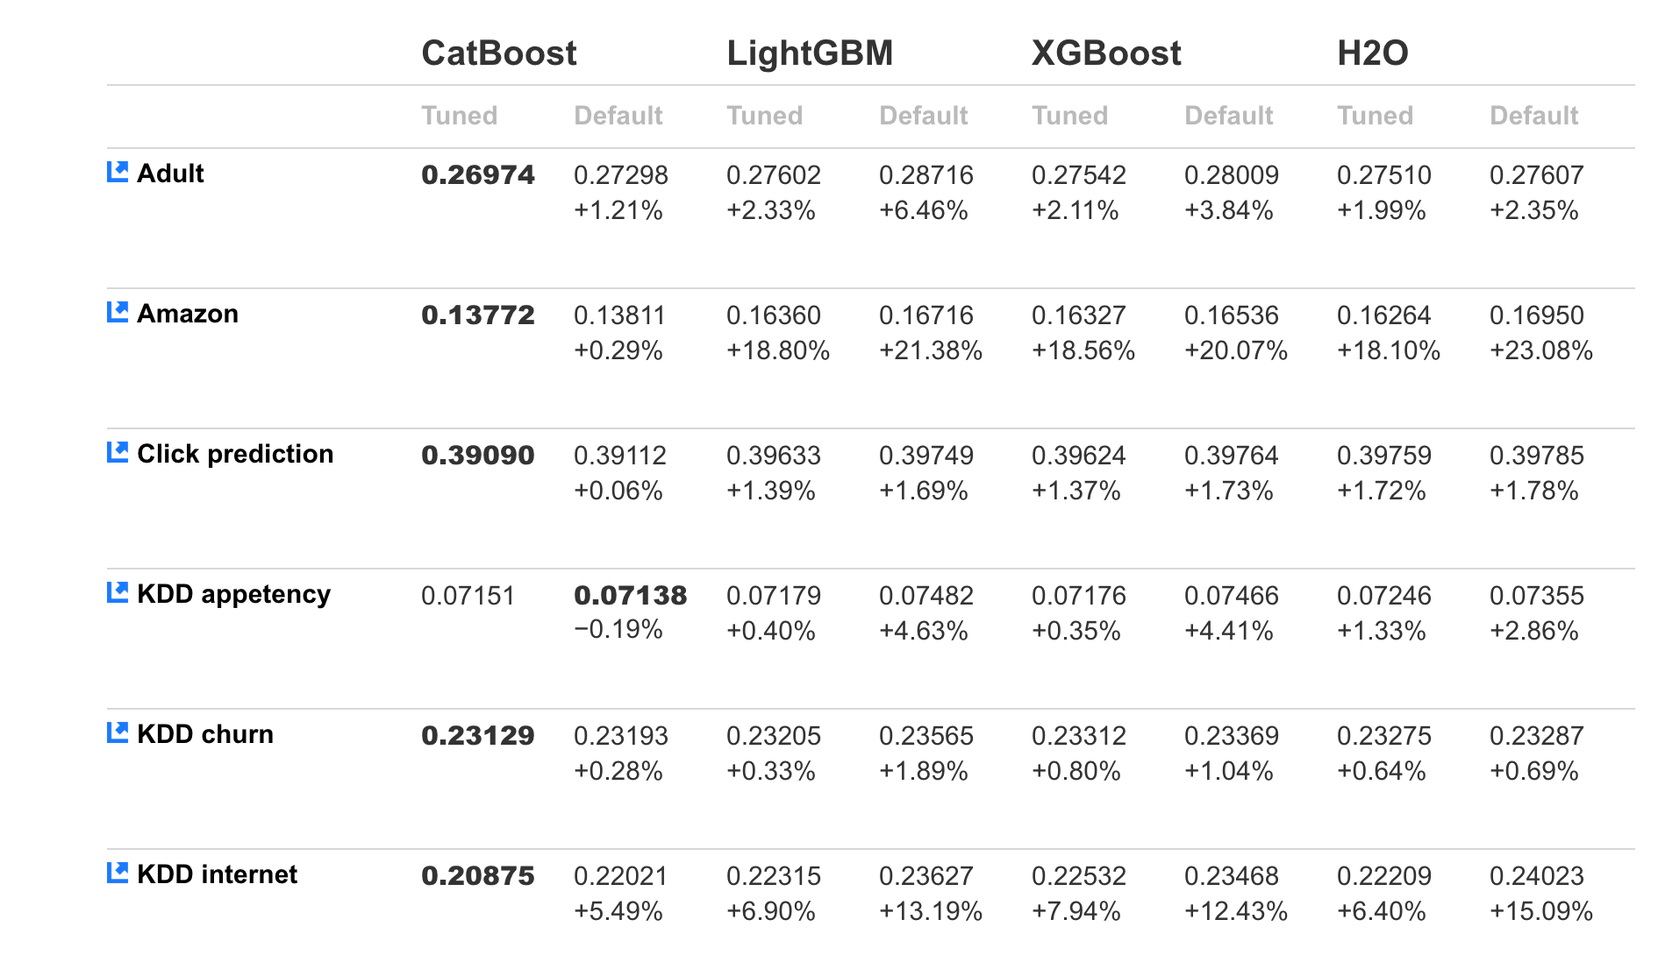
CatBoost
A variant of GBDT
Effectively handles categorical features
Builds an ensemble of decision trees
Available as an open-source library
Easy to use
Best solution for heterogeneous data
Works well for small data set
Scalable for big datasets

Slide 6
Results
Compared to Scikit-learn models
LSTM model scored 1.518 on Kaggle
Random Forest scored 1.540
CatBoost scored 1.620

